Slide 1
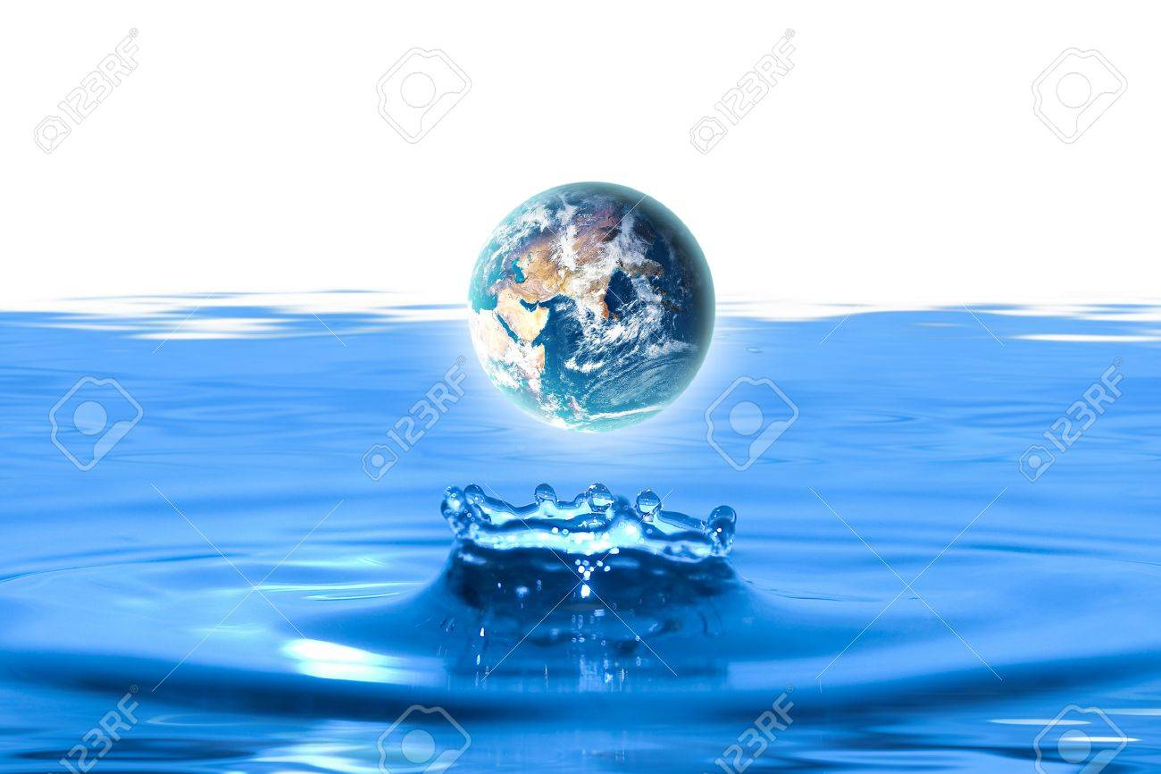
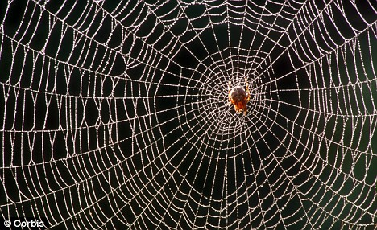
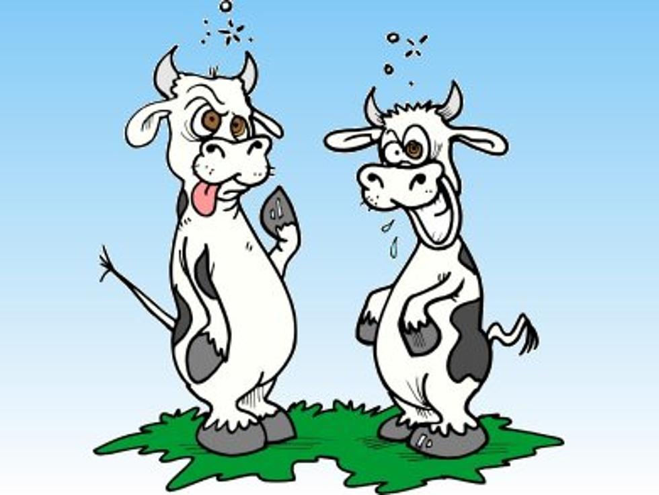
Day 1 – Water, spider silk and mad cows
Dr. Chandra Emani

Slide 2
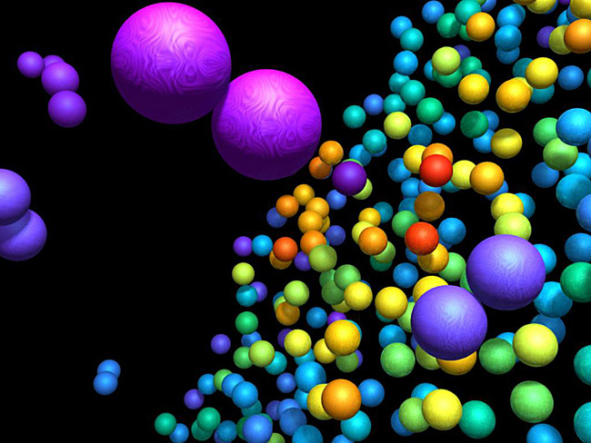
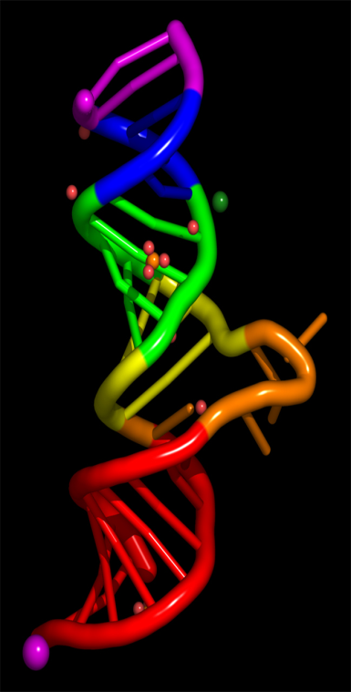

Atoms,
Molecules
and LIFE

Slide 3
What are we going to learn?
What are atoms?
What are molecules?
Why and how are they important for LIFE?

Slide 4
What are atoms?
Historical overview of atomic theory
Sub-atomic particles
Elements and isotopes
How Electrons are crucial for LIFE

Slide 5
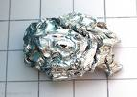
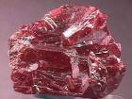

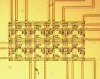
A vision of an Atom
Gallium
Arsenic
Manganese
Magnetic semiconductor

Slide 6
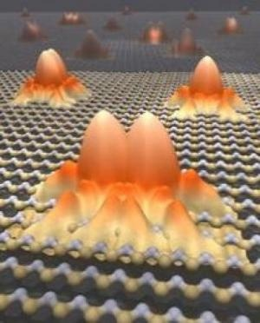
A vision of an Atom

Slide 7

How small is an Atom?
The tip of a pin has
1, 000, 000, 000, 000, 000, 000 atoms
(1 trillion)

Slide 8
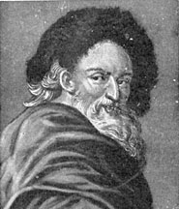
Who coined the term “Atom”?
Democritus
Greek Philosopher
250 B.C.
He powdered Sea shells and called the smallest particles atoms (“Atomos” in Greek means “indivisible”)
Democritus means “chosen by the people”
The root of the word “Democracy”

Slide 9
Where do Atoms come from?
Atoms are parts of Elements
An element is a substance that cannot be broken down by ordinary chemical reactions
There are 96 types of naturally occurring elements
e.g. Hydrogen, Oxygen, Iron, Gold, Mercury

Slide 10

The basis of concept of Atom
The law of conservation of mass
“The masses of individual elements remain same before and after a chemical reaction.”
Antoine Lavoisier
French Chemist
Father of modern chemistry

Slide 11
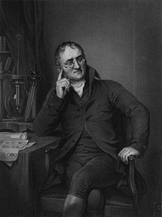
Dalton’s Atomic Theory
Elements are made of tiny particles called atoms
All atoms of a given element are identical.
The atoms of a given element are different from those of any other element and can be distinguished from one another by their respective relative weights.
Atoms of one element can combine with atoms of other elements to form compounds.
Atoms cannot be created, divided into smaller particles, nor destroyed in the chemical process; a chemical reaction simply changes the way atoms are grouped together.
John Dalton
English Chemist

Slide 12
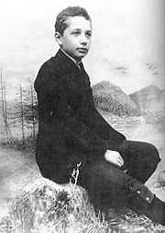
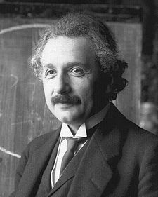
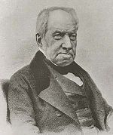
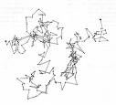
Do Atoms Exist?
Albert Einstein
Concept of “Brownian motion”
A pollen grain suspended in water observed under a microscope shows a zigzag movement due to the movements of atoms in water.
Robert Brown

Slide 13
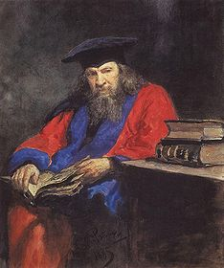
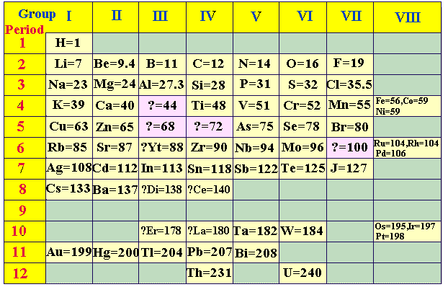
Atomic weight – The first periodic table
Dmitri Mendeleev
Russian Chemist

Slide 14
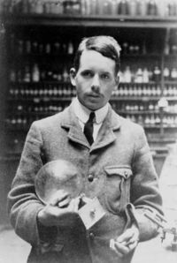
Atomic Number
Moseley’s Law
The law that the square-root of the frequency of an x-ray spectral line belonging to a particular series is proportional to the difference between the atomic number and a constant which depends only on the series.
Simply,
Every atom gives a unique pattern of lines when you pass x-rays through it and that pattern depends on what is known as an atomic number.
Henry Moseley
English Physicist

Slide 15
Atomic Spectra and Atomic Number
Glass (Prism)
Hydrogen
Helium

Slide 16
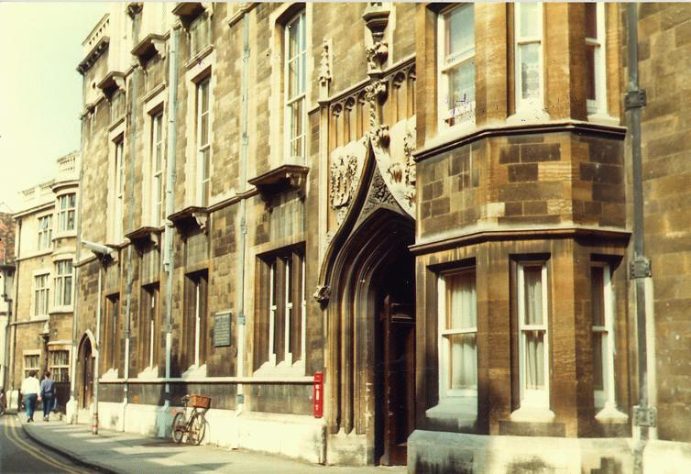
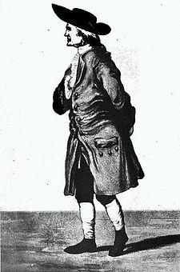
Cavendish Laboratory
Sir Henry Cavendish,
Discoverer of Hydrogen
Cambridge, England

Slide 17
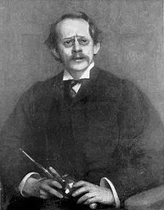

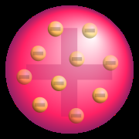

The first Atomic Model
Cathode Ray Tube
J. J. Thomson
English Physicist
Nobel Prize 1906
Plum pudding Model

Slide 18
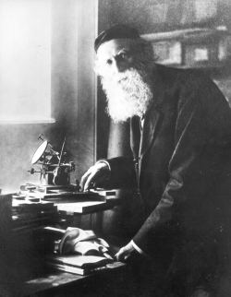
Electrons
Thomson called the –ve particles “corpuscles”
Stoney classified them as the smallest particles of electric current and named them “Electrons”
George Johnstone Stoney
Irish Physicist

Slide 19
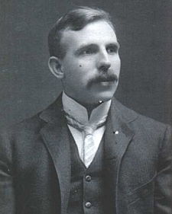
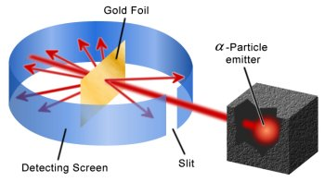

The second Atomic Model
Gold foil Experiment
Earnest Rutherford
New Zealand Physicist
Nobel Prize 1908

Slide 20
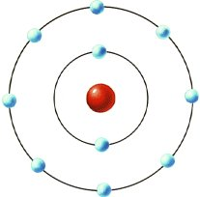

The second Atomic Model
Also known as Planetary Atomic Model
Atom has a central core of positive charge called “Nucleus” (meaning “Kernel” in Greek; derived from “Nux” meaning “Nut”)
The positive particles were named “Protons” (from “protos” meaning “first” – the number of protons is the atomic number
The electrons revolve around the nucleus in circular or elliptical “orbits”

Slide 21
Discrepancy in Rutherford Model
The negatively charged electrons will get attracted to the positively charged protons in the nucleus
As the electrons revolve, they continuously lose energy and collapse into the nucleus

Slide 22
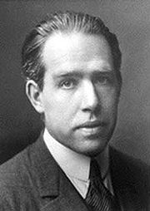
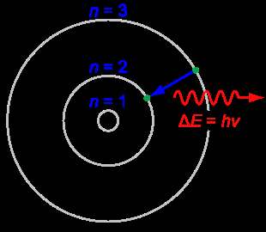
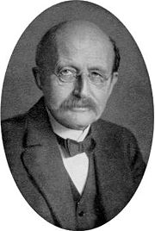
The final Atomic model
Niels Bohr
Danish Physicist
Nobel Prize 1922
Max Planck
German Physicist
Nobel Prize 1918

Slide 23
The final Atomic model
Also known as Rutherford-Bohr Model
Electrons travel around nucleus in fixed “quantized” orbits (from “quanta” meaning “how great” or “how much”)
The energy of the electron is fixed as discrete energy packets called “quanta”
Energy is not lost by the electrons while in orbit but emitted out as light, according to the formula:
∆E = hν, where E=energy, h= Planck’s constant
ν = frequency of the electron wave

Slide 24
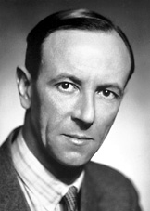
Neutron
Neutron (from the word “neutral”) is the uncharged sub-atomic particle in the nucleus along with the positively charged protons
Protons and neutrons make up the atomic weight of the atom
James Chadwick
English Physicist
Nobel Prize 1935

Slide 25
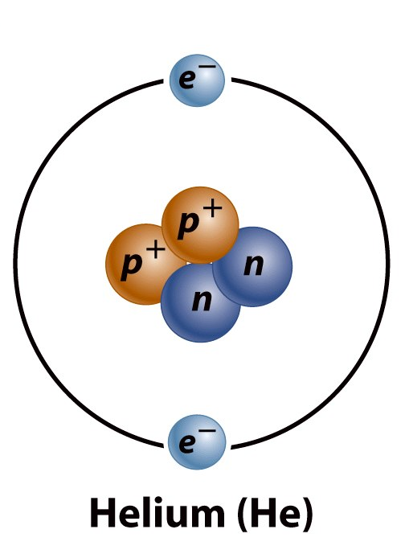
Summing up – Atomic Structure
Atoms are the fundamental structural units of matter and are composed of three types of particles called sub-atomic particles
In the central nucleus there are positively charged protons and uncharged neutrons
In orbit around the nucleus are negatively charged particles called electrons

Slide 26
Important features of an Atom
Atoms are “electrically neutral” since the number of positive protons always equals the number of negative electrons
The number of protons in the nucleus is known as the atomic number
The sum of protons and neutrons is known as the atomic weight

Slide 27
Elements
Atoms are parts of 96 naturally occurring substances called “elements”
The atomic number (number of protons) is the defining value for an element
  All atoms of an element have the same atomic number
  e.g. Carbon has 6 protons, nitrogen has 7

Slide 28
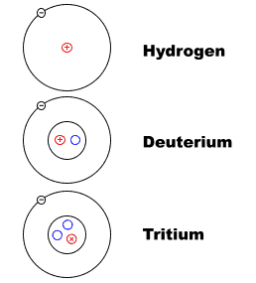
Elements and “Isotopes”
Atoms in an element have the same atomic number and hence same number of protons.
Sometimes elements with same atomic number (or protons) have different numbers of neutrons. These are called “isotopes”
(meaning “at the same place”)

Slide 29
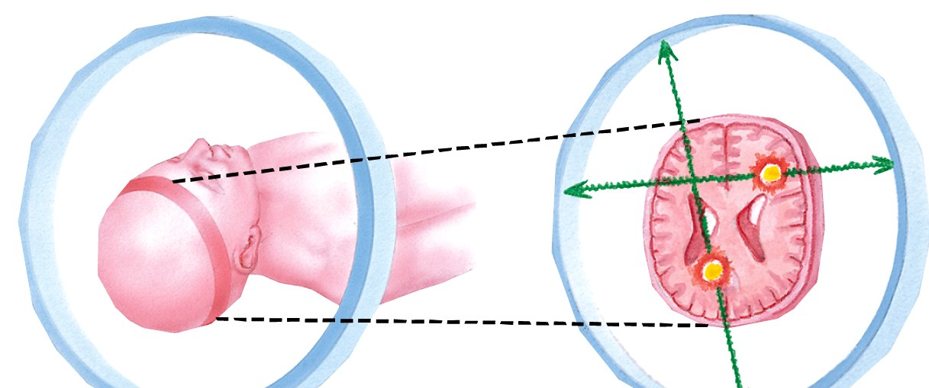
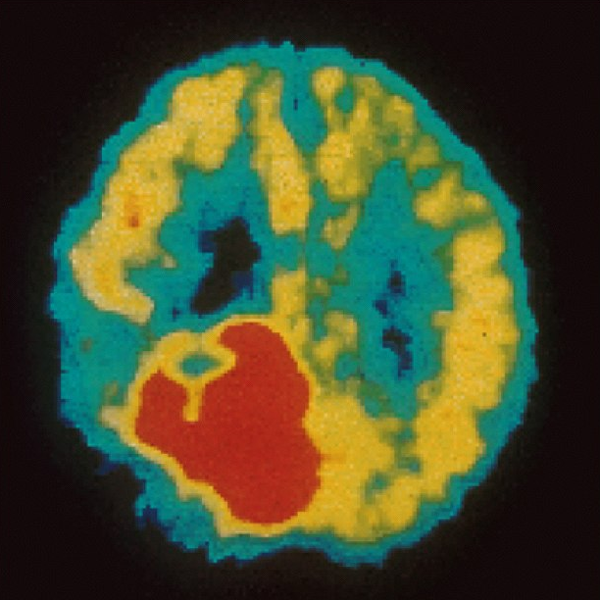
Radioactive Isotopes – “PET scan”
“PET ”- Positron Electron Tomography
Patient is given a glucose sugar with an isotope of fluorine attached.
Malignant tumors show up as red.

Slide 30
Elements of LIFE
“CHNOPs”
C – Carbon
H – Hydrogen
N – Nitrogen
O – Oxygen
P – Phosphorus

Slide 31
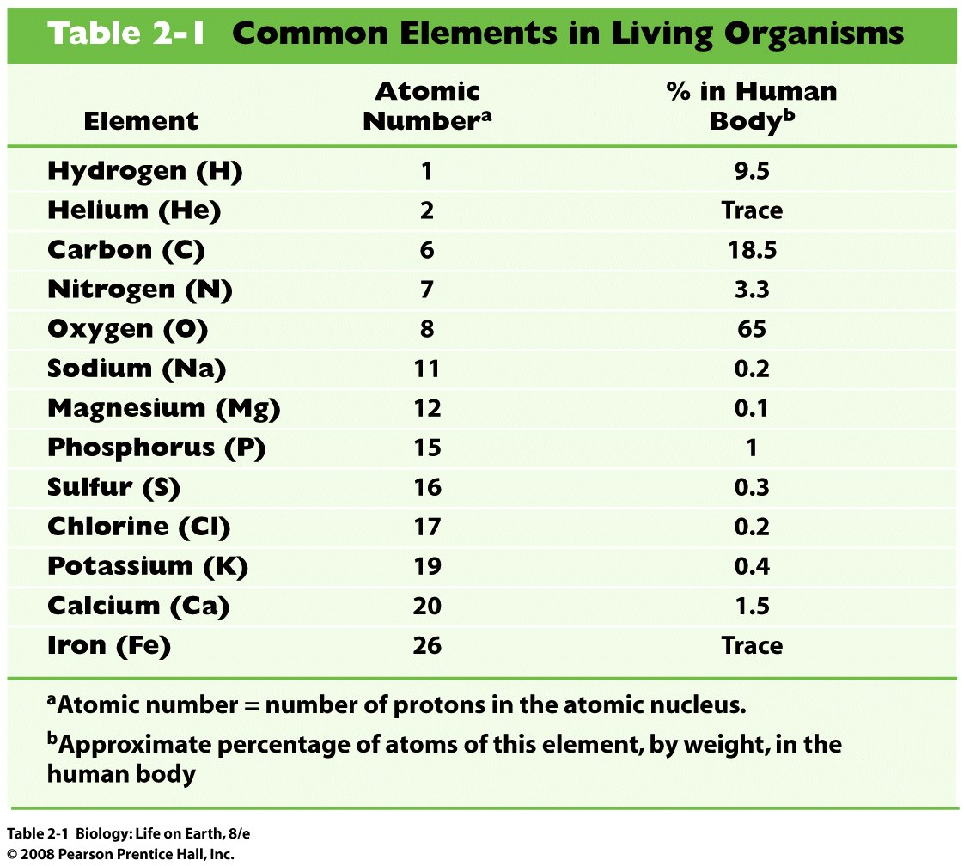

Slide 32
Electron Shells
Due to mutual repulsion, only limited number of electrons occupy the space closest to nucleus
Larger atoms can accommodate more electrons than smaller ones can
Electrons are distributed about the nucleus of an atom in electron shells
  The first shell or energy level holds 2 electrons
  The second shell holds up to 8

Slide 33
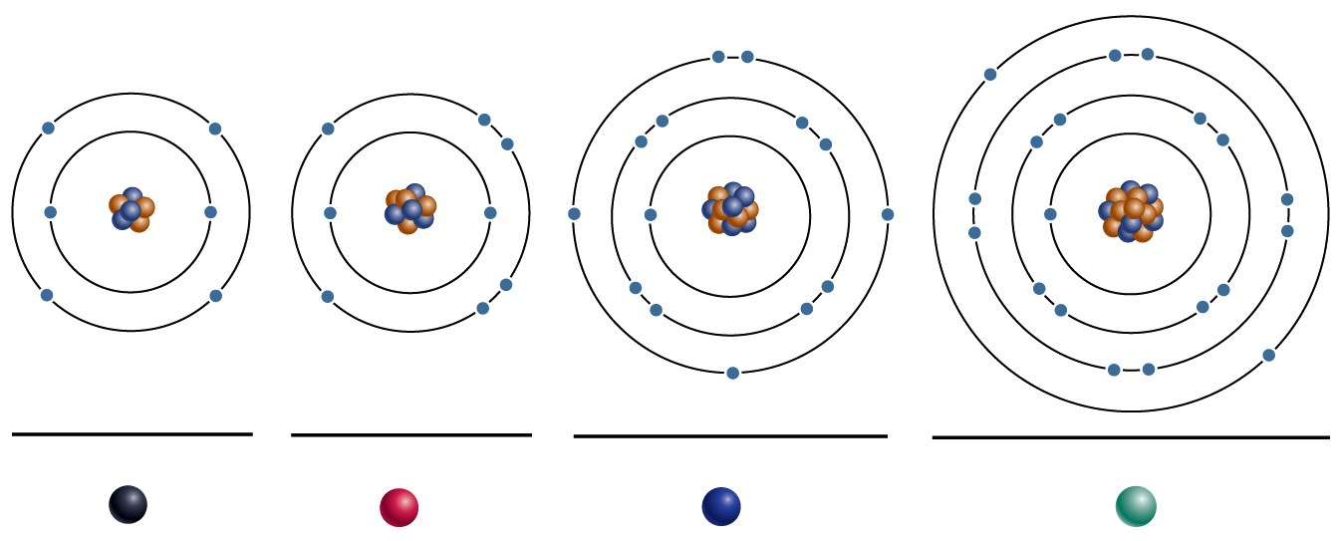
Electron Shells
2e–
5e–
8e–
4e–
6e–
8e–
8e–
2e–
2e–
2e–
2e–
6p⁺
8p⁺
15p⁺
20p⁺
6n
8n
16n
20n
Carbon (C)
Oxygen (O)
Phosphorus (P)
Calcium (Ca)
C
O
P
Ca

Slide 34
Electrons are crucial for LIFE
Nucleus in the atom provides stability, while electrons are crucial for interactions with other atoms to form molecular structures
Life depends on electrons capturing and releasing energy
  Electron shells correspond to energy levels
  Energy exciting an atom causes an electron jump from a lower- to higher-energy shell
  Later, the electron falls back into its original shell, releasing the energy

Slide 35
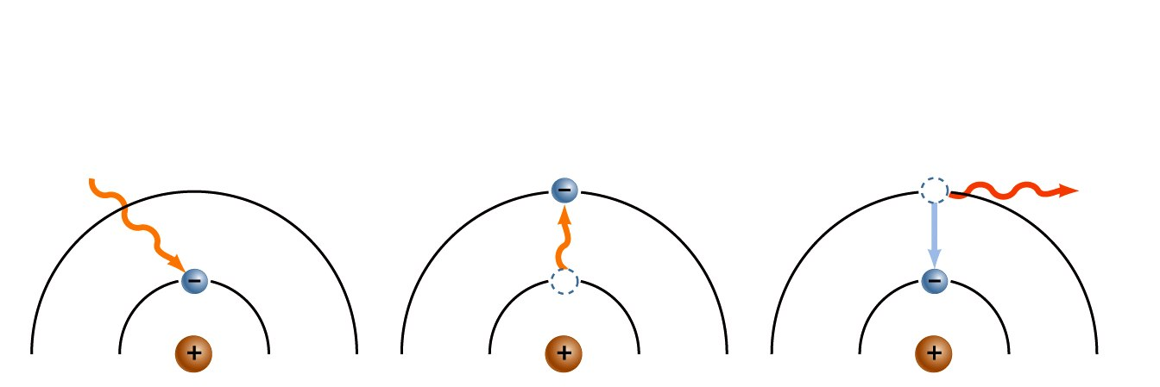
Electrons are crucial for LIFE
1 An electron
absorbs energy.
2 The energy boosts
the electron to a
higher energy level.
3 Electron drops
back into lower-
energy shell,
releasing energy
as light.
energy
light
Life depends on electrons capturing and releasing energy

Slide 36
What are molecules?
How atoms interact to form molecules ?
What kind of interactions are seen in biomolecules ?
What are free radicals ?
How chemical bonding is crucial for LIFE ?

Slide 37
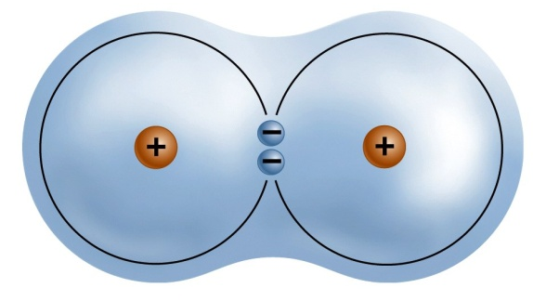
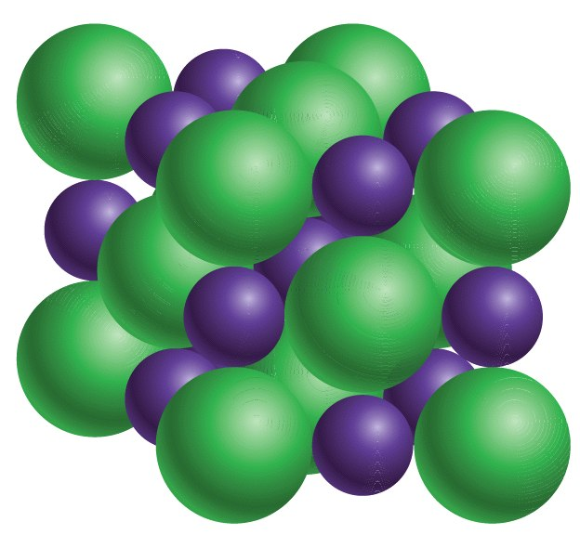
What happens when atoms interact?
When two or more atoms bond together through electron shell interactions, molecules are formed.
A substance made of atoms of different elements is what is called a compound
Hydrogen molecule
Cl–
Na⁺
Cl–
Na⁺
Cl–
Na⁺
Sodium Chloride

Slide 38
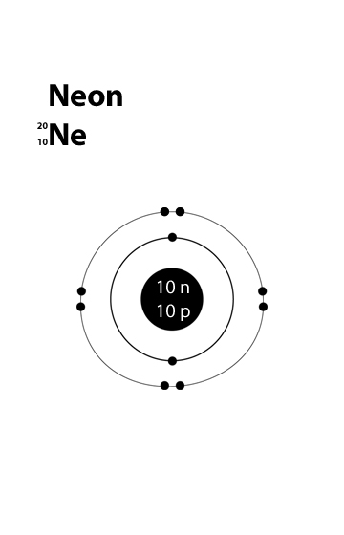
What does atomic interaction depend on?
Reactions between atoms depend upon the configuration of electrons in the outermost electron shell
Atoms will not react with other atoms if the outermost shell is completely empty or full (such atoms considered inert)
  Example: Neon, with 8 electrons in outermost shell (full)

Slide 39
What kind of atoms react?
Atoms will react with other atoms if the outermost shell is partially full (such atoms considered reactive)
  Example: Oxygen, with 6 electrons in outermost shell (can hold 2 more electrons)
6e–
2e–
8p⁺
8n
Oxygen (O)
C
P
O

Slide 40
Why and how do atoms interact?
Reactive atoms gain stability by electron interactions (chemical reactions)
  Electrons can be lost to empty the outermost shell
  Electrons can be gained to fill the outermost shell
  Electrons can be shared with another atom where both atoms have full outermost shells

Slide 41
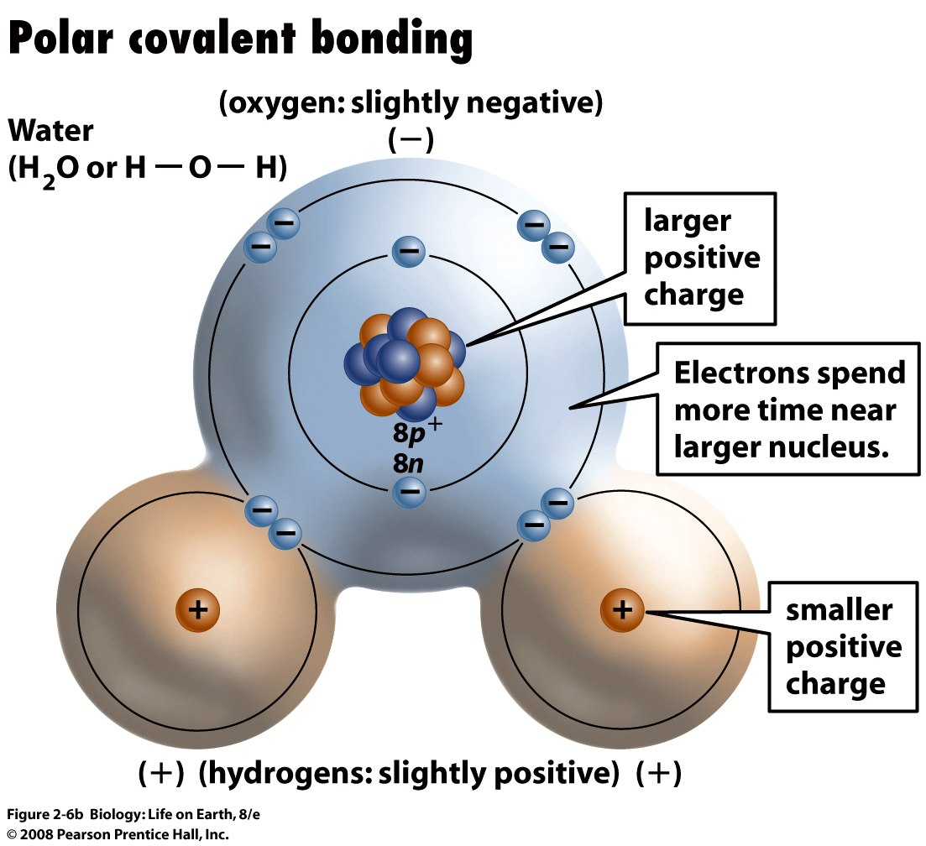
The formation of water molecule

Slide 42
Atomic Interaction – Chemical Bonding
Attractive forces (chemical bonds) hold atoms together in molecules
  Ionic Bond
  Covalent Bond
  Hydrogen Bond

Slide 43
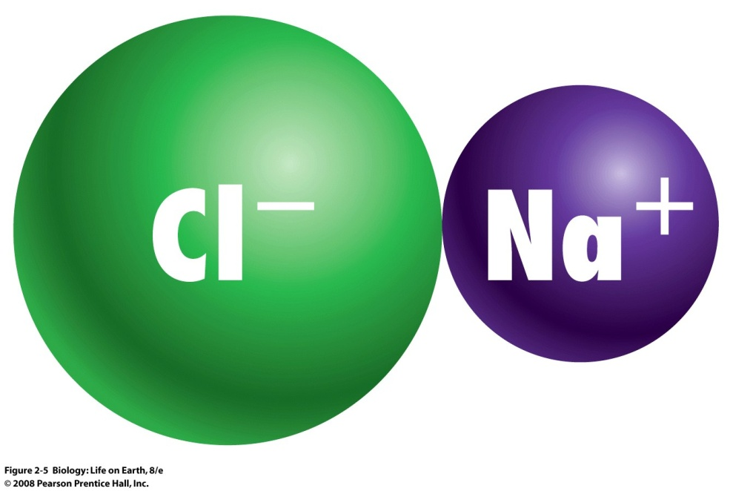
Ions
Atoms that have lost electrons become positively charged ions or cations (e.g. sodium: Na⁺)
Atoms that have gained electrons become negatively charged ions or anions (e.g. chlorine: Cl⁻)

Slide 44
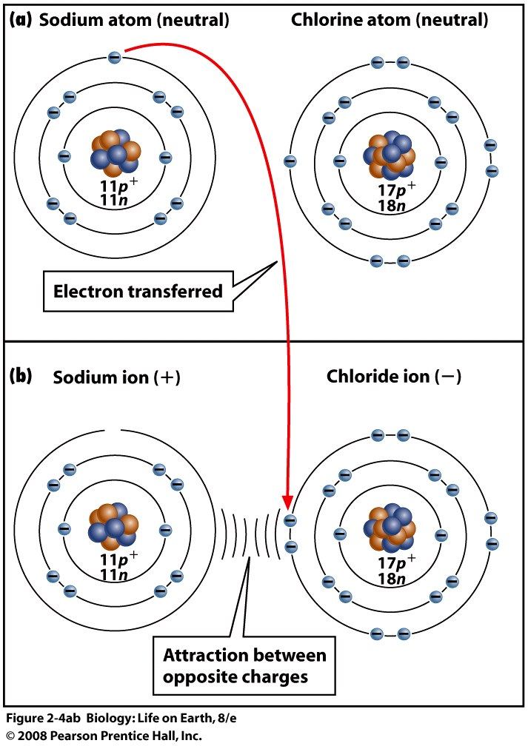
Ionic Bond
Oppositely charged ions are attracted to each other are bound into a molecule by ionic bonds

Slide 45
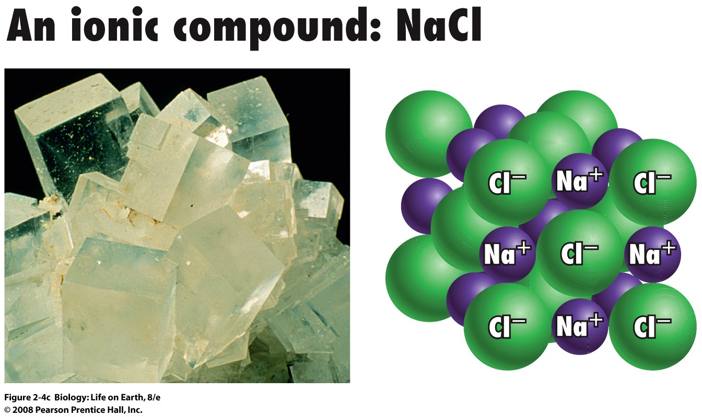
An Ionic Crystal
Salt crystals are repeated, orderly arranged sodium and chloride ions

Slide 46
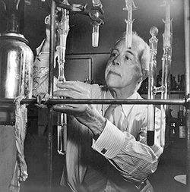
Covalent Bond
Atoms with partially full outer electron shells can share electrons (shared “valency”)
Two electrons (one from each atom) are shared in a covalent bond
Most biological molecules contain covalent bonds
Gilbert Newton Lewis
American Physical Chemist

Slide 47
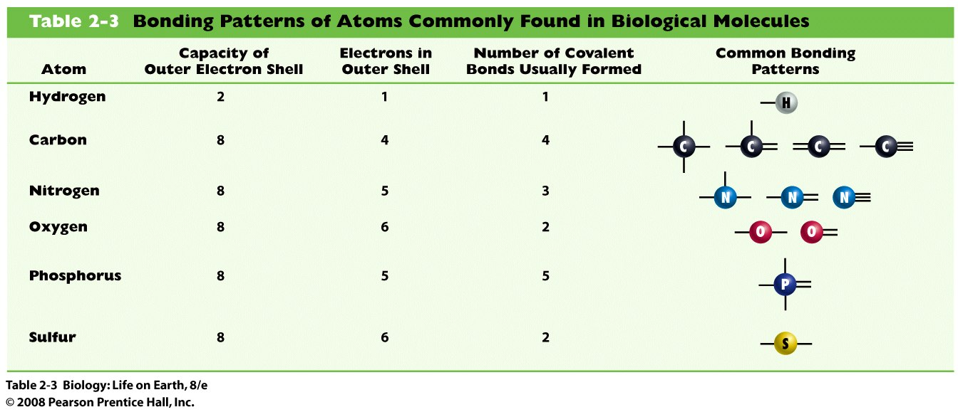
Covalent Bond Patterns
Hydrogen – Single bond
Oxygen – Double bond
Nitrogen – Triple bond

Slide 48
Polar Covalent Bonding
Atoms within a molecule may have different nuclear charges
Those atoms with greater positive nuclear charge pull more strongly on electrons in a covalent bond
In molecules where atoms of different elements are involved (H₂O), the electrons are not always equally shared: these covalent bonds are polar

Slide 50
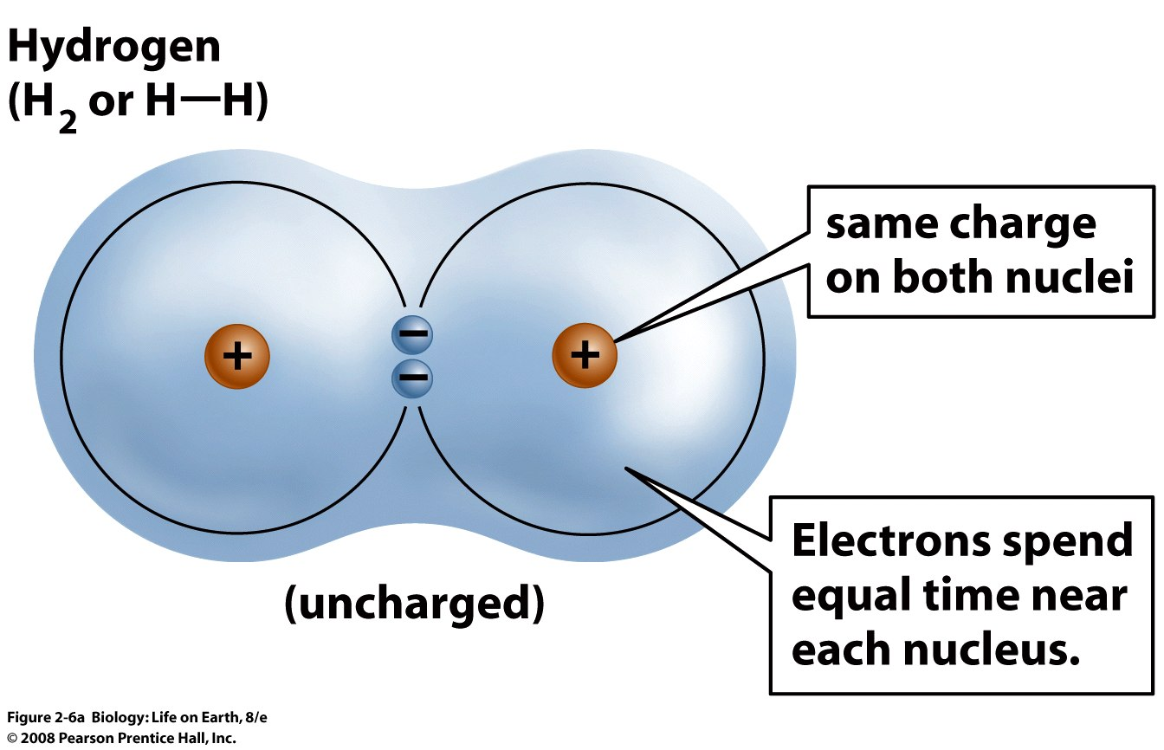
Non-polar Covalent Bonding
In diatomic molecules like H₂, both atoms exert the same pulling force on bond electrons: the covalent bond is non-polar

Slide 51
Hydrogen bonding
Polar molecules like water have partially charged atoms at their ends
Hydrogen bonds form when partial opposite charges in different molecules attract each other
  The partially positive hydrogens of one water molecule are attracted to the partially negative oxygen on another

Slide 52
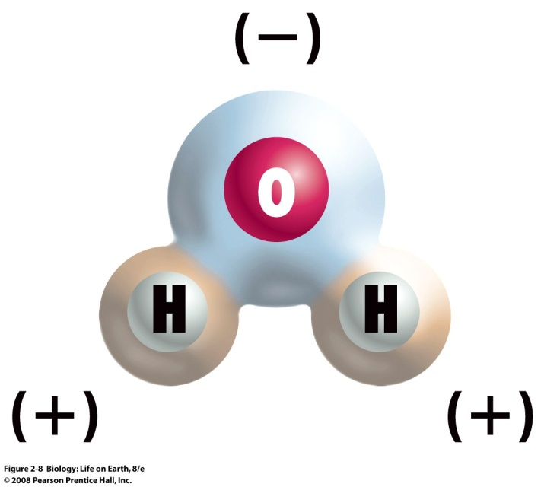
Hydrogen bonding
Polar biological molecules can form hydrogen bonds with water, each other, or even within the same molecule
Hydrogen bonds are rather weak but can collectively be quite strong

Slide 53
Hydrogen bonding – an important property
Hydrogen bonds are rather weak but can collectively be quite strong
Hydrogen bond is responsible for the great internal cohesion of water molecules.

Slide 54
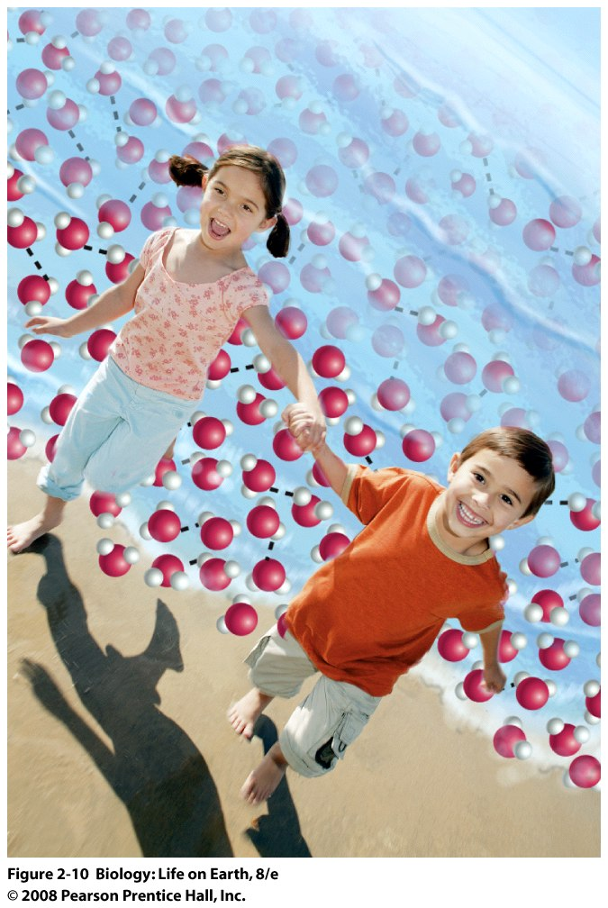
Hydrogen bonding

Slide 55
Take a break
WATER

Slide 56
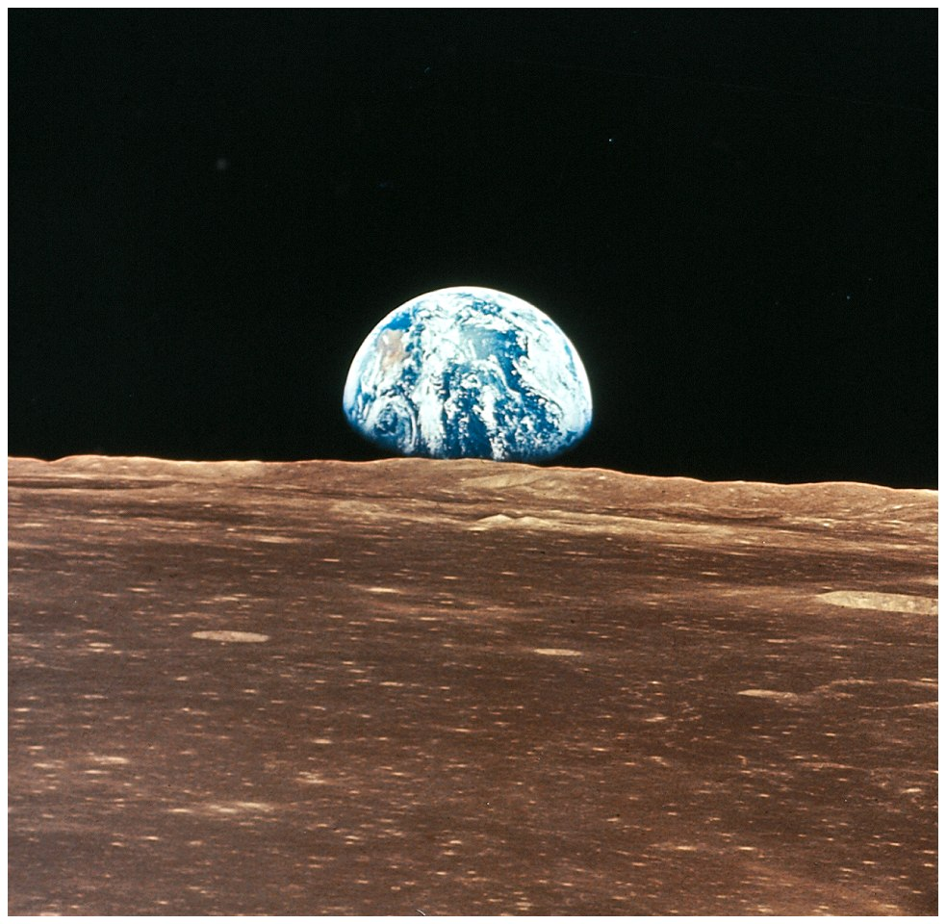
Signs of Life

Slide 57

Water on Mars?

Slide 58
Water is important for LIFE
Water is the most abundant substance in living systems
70% of the weight of all living organisms
The first life forms arose in water
Evolution is shaped in an aqueous environment
Interactions in water molecule and the property of ionization are crucial for both structure and function of biomolecules

Slide 59
The formation of a water molecule

Slide 60
Hydrogen bonding – an important property
Hydrogen bonds are rather weak but can collectively be quite strong
Hydrogen bond is responsible for the great internal cohesion of water molecules.

Slide 61
Hydrogen bonding is responsible for the unusual properties of water
A high melting point (0◦C)
A high boiling point (100◦C)
A high heat of vaporization (2260◦C)
In comparison with other solvents-
Water 0 100 2,260
Methanol (CH3OH) 98 65 1,100
Ethanol (CH3CH2OH) 117 78 854
Propanol (CH3CH2CH2OH) 127 97 687

Slide 62

Water is an excellent solvent
A wide range of substances dissolve in water
Owing to its molecular interactions, water is a polar solvent

Slide 63

Water interacts with many molecules
Water soluble molecules are hydrophilic
(“Hydro” – water ; “philic” – loving)
e.g. Sugars, Amino acids, Salts

Slide 64
Water interacts with many molecules
Water-insoluble molecules are hydrophobic
(“hydro” –water ; “phobic” – fearing)
  Water molecules repel and drive together uncharged and non-polar molecules like fats and oils
  The “clumping” of non-polar molecules is called hydrophobic interaction

Slide 65

Water interaction with fats – an important consequence for LIFE

Slide 66

Water interaction with fats – an important consequence for LIFE
The formation of “micelles” led to the precursors of cells

Slide 67


Water molecules tend to stick together
Cohesion of water molecules along a surface produces surface tension (tendency of the water surface not to be broken
  Fishing spiders and water striders rely on surface tension to move across the surface of ponds

Slide 68

Water molecules tend to stick together
Hydrogen bonding between water molecules produces high cohesion
  Water cohesion explains how water molecules can form a chain in delivering moisture to the top of a tree

Slide 69

Water molecules tend to stick together
Water molecules stick to polar or charged surfaces in the property called adhesion
  Adhesion helps water climb up the thin tubes of plants to the leaves

Slide 70

Water molecules tend to stick together
Ascent of sap theory
Water molecules climb through plant vessels due to electromagnetic pulsations of living cells
Jagadish Chandra Bose
Indian Biophysicist

Slide 71
Water molecules tend to stick together
Important consequences of cohesion and adhesion of water molecules and the movement of water in plants-
The evolution of tall land plants
The increased photosynthesis
Increased amounts of oxygen in atmosphere due to photosynthesis
The evolution of terrestrial life

Slide 72

Ionization of water
A small fraction of water molecules break apart into ions:
H₂O → OH⁻ + H⁺
Hydrogen ion
Hydroxide ion

Slide 73

Acids
Solutions where H⁺ > OH⁻ are acidic
  e.g. Hydrochloric acid ionizes in water:
    HCl → H⁺ + Cl⁻
  Lemon juice and vinegar are naturally produced acids
  The sour taste of lemon juice is due to the way the receptors of your tongue respond to the H⁺ ions.
Svante Arrhenius
Swedish Physicist

Slide 74
Bases
Solutions where OH⁻ > H⁺ are basic
  e.g. Sodium hydroxide ionizes in water:
  NaOH → Na⁺ + OH⁻
  Baking soda, chlorine bleach, and ammonia are basic
Neutral Solution
Solutions where OH⁻ = H⁺ are neutral
Pure water is neutral

Slide 75
Hydrogen ion concentration - pH
The degree of acidity of a solution is measured using the pH scale
  pHs 0-6 are acidic (H⁺ > OH⁻)
  pH 7 is neutral (H⁺ = OH⁻)
  pH 8-14 is basic (OH⁻ > H⁺)
  pH
  The symbol “p” means “ negative logarithm of ”
  H⁺ concentration in moles/liter
  Mole = weight of substance / molecular weight

Slide 76

The pH scale

Slide 77
Buffers
A buffer is a compound that accepts or releases H⁺ in response to pH change
In the cell interior they maintain a neutral pH to prevent cell death due to increased acidity or basicity.
If H⁺ ion concentration increases, buffers combine with them; if it falls, buffers release H⁺ ions.

Slide 78
Buffers maintain blood pH
If the blood becomes too acidic, bicarbonate accepts (and absorbs) H⁺ to make carbonic acid
HCO₃⁻ + H⁺ → H₂CO₃
bicarbonate hydrogen ion carbonic acid
If the blood becomes too basic, carbonic acid liberates hydrogen ions to combine with OH⁻ to form water
  H₂CO₃ + OH⁻ → HCO₃⁻ + H₂O
  carbonic acid hydroxide ion bicarbonate water

Slide 79
Water stabilizes temperature
Very low or very high temperatures may damage enzymes or slow down important chemical reactions
Water requires a lot of energy to turn from liquid into a gas (heat of vaporization) - 2260◦C
  Evaporating water uses up heat from its surroundings, cooling the nearby environment (as occurs during sweating)

Slide 80
Water stabilizes temperature
Water moderates the effect of temperature change
  Temperature reflects the speed of molecular motion
  It requires 1 calorie of energy to raise the temperature of 1g of water 1ºC (the specific heat of water), so it heats up very slowly

Slide 81

Water stabilizes temperature

Slide 82

Water stabilizes temperature
Water requires a lot of energy to be withdrawn in order to freeze (heat of fusion)
Water freezes more slowly than other liquids

Slide 83

Ice
Most substances become denser when they solidify from a liquid
Ice is unusual because it is less dense than liquid water

Slide 84

Ice
Water molecules spread apart slightly during the freezing process

Slide 85
Ice
Ice floats in liquid water and forms an insulating layer that delays freezing blow its layer.
Ponds and lakes freeze from the top down and never freeze completely to the bottom
  Many plants and fish therefore are not frozen

Slide 86


Slide 87
Take a break
Biomolecules – Proteins

Slide 88


Slide 89


Killer Proteins - Prions

Slide 90
Proteins
What Are Proteins?
  What are the functions of Proteins?
  How are proteins formed?
  What is the structure of proteins?
  How is the structure of proteins linked to their function?

Slide 91

Proteins
Coined in 1863
The word protein comes from the Greek word “proteios” meaning “first place”
He opined that proteins are substances prepared by plants for herbivores or the grass eating animals
Jon Jakob Berzelius
Swedish Biochemist

Slide 92



Structural Proteins

Slide 93


Slide 94
Proteins are polymers of Amino acids
Proteins are formed from chains of amino acids (monomers)
All amino acids have similar structure
  All contain “amino” and “carboxyl (acid)” groups,
  hence the name
  All have a variable “R” group
    Some R groups are hydrophobic
    Some are hydrophilic
    Cysteine R groups can form disulfide bridges

Slide 95

Amino acids
(Functional group)
Hydrophilic
Hydrophobic
Sulfur-containing
(-NH₂)
(COOH)

Slide 96

Stereochemical projection
Stereochemical renderings are useful for visualizing the shape of the molecule
Wedges are used to depict the direction of the bond projection. A solid wedge shows the bond projecting towards the viewer out of the plane. A dashed wedge shows the bond projecting behind the plane, away from the viewer. The remaining bonds are predicted in straight line

Slide 97

Amino acids – Functional Groups

Slide 98

Amino acids – Functional Groups

Slide 99

Amino acids – Functional Groups

Slide 100

Ionization as a structure of function

Slide 101

Sequence or the order of Amino acids dictates protein function
Amino acids are joined to form chains by dehydration synthesis
  An amino group reacts with a carboxyl group, and water is lost

Slide 102
Peptide Bond
The covalent bond formed between amino acids is called the peptide bond (comes from the word “pepsin” the digestive juice in stomach; “peptos” means cooked)
Peptide bonds join long chains of amino acids and hence, proteins are referred to as polypeptides

Slide 103

Essential Amino Acids must be obtained from diet
Edema

Slide 104


Slide 105

Analysis of proteins – Protein Sequencing
Sequenced Insulin
Used a compound called Fluorodinitrobenzene (FDNB or Sanger’s reagent) to react with the N-terminal amine groups
He then chopped the insulin into shorter chains and separated them on a paper in the presence of electricity (Electrophoresis)
The individually separated amino acids were then detected as yellow spots using a compound called Ninhydrin reagent
Fred Sanger
British Biochemist
Nobel, 1958 and 1964

Slide 107


Structure of proteins
Analysis of protein structure started with purification and crystallization
Urease
Pepsin
James Sumner
American Biochemist
Nobel, 1946
John Northrop
American Biochemist
Nobel, 1946

Slide 108


Structure of proteins
Protein structure is determined by X-ray crystallography (first done in metallic elements
Youngest Nobel Laureate, 25 years
Lawrence Bragg
British Physicist
Nobel, 1915
William Bragg
British Physicist
Nobel, 1915

Slide 109



Structure of proteins – X-ray crystallography

Slide 110
Structure of proteins
Proteins exhibit up to four levels of structure
  Primary structure is the sequence of amino acids linked together in a protein
  Secondary structures are helices and pleated sheets
  Tertiary structure refers to complex foldings of the protein chain held together by disulfide bridges, hydrophobic/hydrophilic interactions, and other bonds
  Quaternary structure is found where multiple protein chains are linked together

Slide 111


Slide 112


Secondary structure- pleated sheet
Linus Pauling and Robert Corey
American Chemists
Nobel, 1915
Notes:
FIGURE 3-22 The pleated sheet is an example of protein secondary structure
In a pleated sheet, a single polypeptide chain is folded back upon itself repeatedly (connecting portions not shown). Adjacent segments of the folded polypeptide are linked by hydrogen bonds (dotted lines), creating a sheetlike configuration. The R groups (green) project alternately above and below the sheet. Despite its accordion-pleated appearance, produced by bonding patterns between adjacent amino acids, each peptide chain is in a fully extended state and cannot easily be stretched farther. For this reason, pleated sheet proteins such as silk are not elastic.

Slide 113

Tertiary structure- disulfide bridges
Notes:
FIGURE 3-23 Keratin structure

Slide 114


Quartenary structure- Hemoglobin
Max Perutz
British Biophysicist
Nobel, 1962
Hemoglobin
John Kendrew
British Biophysicist
Nobel, 1962
Myoglobin

Slide 115
Three dimensional structure of proteins
The type, position, and number of amino acids determine the structure and function of a protein
  Precise positioning of amino acid R groups leads to bonds that determine secondary and tertiary structure
  Disruption of these bonds leads to denatured proteins and loss of function
e.g. Fried eggs, yolk changes from clear to white

Slide 116

single hair
enlargement
of single hair
hair cell
microfibril
helix of
single keratin
molecule
protofibril
disulfide bridges
hydrogen bonds

Slide 117

Osteogenesis imperfecta or brittle bone disease, occurs if a mutation results in the substitution of another amino acid in place of glycine

Slide 118

Defects in collagen structure lead to pathological conditions
Hydroxyproline, a modified version of proline in which a hydroxyl group replaces a hydrogen, is important for the stabilization of collagen
Vitamin C is required for the formation of hydroxyproline. A lack of vitamin C results in scurvy.

Slide 119
Free Radicals
Some cellular reactions produce molecules whose atoms have one or more unpaired electrons in their outer shells
These unstable molecules (often oxygen atoms) are called free radicals
Free radicals are highly unstable and reactive
  Free radicals steal electrons, destroying other molecules
  Cell death can occur from free radical attack

Slide 120

Free Radicals

Slide 121

Free Radicals
Free radicals are involved in causing heart disease, Alzheimer’s, cancer, and aging

Slide 122


Free Radicals
Antioxidants like vitamins C and E, flavenoids in cocoa render free radicals harmless

Slide 123

Killer Proteins - Prions
Creutzfeldt-Jakob disease – first human victim in US in 2001
Mad Cow disease
(Bovine spongiform encephalitis or BSE)
Scrapie in Sheep
Disease attributed to “Prions” (Protein infectious particles)

Slide 124

Killer Proteins - Prions
A change in secondary structure of proteins

Slide 125


Killer Proteins - Prions
Stanley Prusiner
American Neurobiologist
Nobel, 1997
What exactly caused the change to Killer Proteins?

Slide 126
Tomorrow
Life’s Lock and Keys

